Slide 1
Convergence check for different algorithms

Slide 2
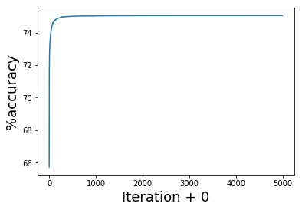
Logistic GD, 5000 iter, st_size=0.625
75.0572

Slide 3
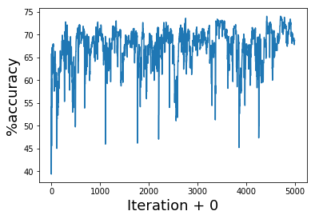
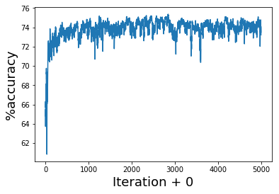
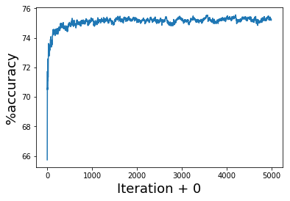
Logistic SGD, 1 sample ,5000 iterations, stsize same
once
10 times average
100 times average
74.056
75.3504
75.564

